Slide 1
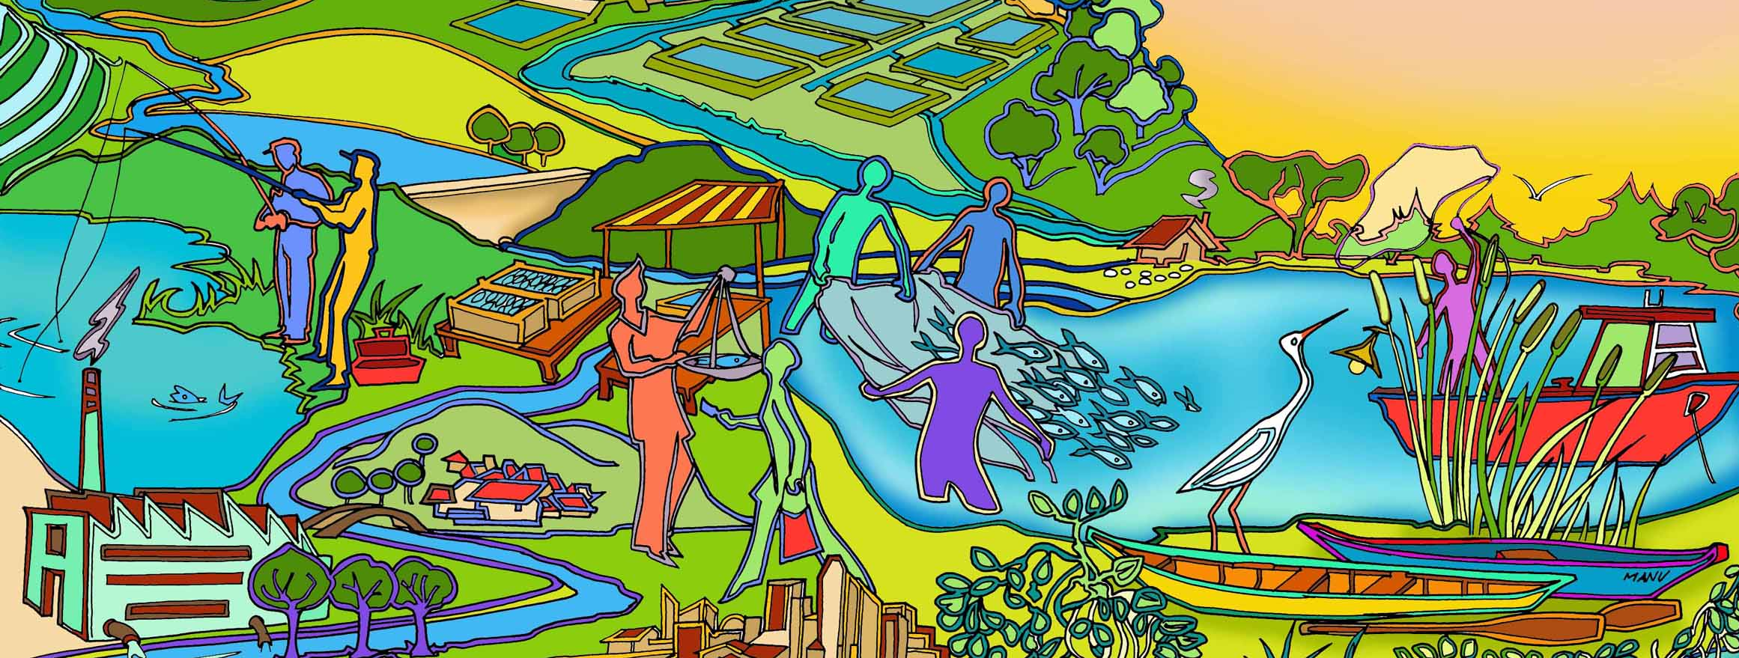
Session 11 Steps 2.1 – 2.3 Identify and prioritize issues and goals
Essential EAFm training
Date |Place

Slide 2
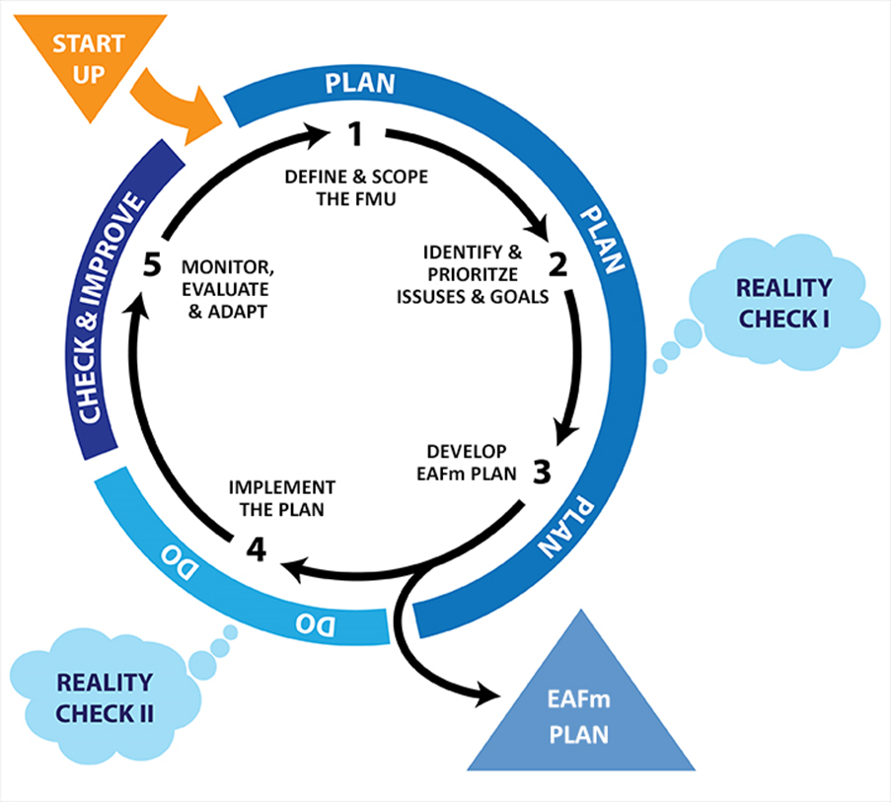
Notes:
We are now at Step 2. There are 3 sub-steps (i) identify the threats and issues, (ii) define the goals for the FMU and (iii) prioritize the issues.
Refer to large visual of this on wall (keep up as reference throughout course).

Slide 3
Session objectives
After this session you will be able to:
Identify your FMU-specific issues
Prioritize issues through risk assessment
Develop goals for the EAFm plan
Notes:
Self explanatory

Slide 4
2.1 Identify threats and issues for the FMU
What are the specific threats and issues for the FMU?
Cover the 3 EAFm components
Notes:
2.1. The next step is for stakeholders to undertake an initial evaluation of threats and issues associated with the FMU. This should cover economic/social, ecological + governance considerations.

Slide 5
Problems, causes and effects
Wide variety of problems
Some are very broad (e.g. climate change, pollution)
Some are very specific (e.g. poison fishing, barriers)
This is because there is a mixture of causes and effects of the issue
One tool that helps separate out causes and effects is called a Problem Tree
EFFECTS
PROBLEM
CAUSES
CAUSES
CAUSES
CAUSES
Notes:
Looking at the issues already identified earlier, you will notice that some are very broad (e.g.. climate change and pollution), while others are very specific. This is because some of the “issues” you have identified are causes of the problem and some are effects.
A tool called “Problem tree” can help sort out the causes from the effects.
One possible activity
In groups, discuss the issues and sort them into broad and more specific. The facilitator then organises these ideas into clusters. This process fosters interdependence so called “Causal chain analysis and collaboration”. This is a quick way to gather large amount of data and information from a group. It provides an opportunity to join like ideas and develop synergies, encouraging group creativity.
See also Technical Tool n. 28

Slide 6
Terms used in a problem tree
Effect: the effect created by the problem
e.g. low household incomes; conflicts between fishers
Core problem: the actual problem
Causes: the cause of the problem. Can be further broken down into main causes and underlying causes
Driver: large-scale events that have a flow-on effect on many issues
e.g. climate change; growth in population and wealth
Notes:
Here we define the terms used in a problem tree analysis. Note that a driver is usually something we have no control over.

Slide 7
Problem tree example
Effect
Declining fisher income high debt
Core problem
Declining fish stocks
Main cause
Unregulated, open access fishery
Root Causes
Too many fishers/boats
Use of destructive, & small mesh fishing gear
Population growth, economic growth
(high fish demand, increasing costs)
Driver
Notes:
In this example core problem is declining fish stocks. The effect of this is low income and high debt. The main cause in open access fishery that leads to too many boats and non-selective gear. The over-arching driver is Population and wealth growth forcing need for higher incomes and increasing demand for fish.
Refer to Participant Handbook Module 11, Figure 11.1.

Slide 8
Problem tree example
Declining fish abundance and loss of biodiversity
Effect
Core problem
Poor fish migration and low recruitment
Main cause
Loss of flow/connectivity
Root Causes
Barriers/weirs/ reservoirs
Increased erosion, siltation in watershed and riparian area
Land use change and demand for irrigation and water by agriculture
Driver
Notes:
In this example core problem is declining fish stocks. The effect of this is low income and high debt. The main cause in open access fishery that leads to too many boats and non-selective gear. The over-arching driver is Population and wealth growth forcing need for higher incomes and increasing demand for fish.
Refer to Participant Handbook Module 11, Figure 11.1.

Slide 9
Activity: In your groups
Using the threats and issues related to fisheries and associated ecosystem develop on day 1
Add/remove issues to make them specific to the FMU.
Divide the issues into 4 levels on a flip chart – drivers, effects, core problem, and causes
Note: Some issues may be too broad (e.g. pollution, dams, climate change) and may need to become more specific.
Don’t worry too much if a given issue is hard to categorise. We will revisit later.
Notes:
See details in Session Plan. This is part A of an activity. Participants then carry out a simple “problem tree” by grouping issues into four levels (i) drivers, (ii) effects, (iii) core problems and causes.
Group only takes one Core Problem.
Note there are several Core Problems that the EAFm will try to resolve (social, ecological/fishery, governance)

Slide 10
Using the problem tree
You can use the problem tree to help:
Write section 3 of the EAFm Plan “Threats and Issues”
Identify drivers that can be put aside because they are out of our control
Sort out which are the real core problems and objectives
Identify causes that can be addressed by mgmt. actions
Notes:
The problem tree analysis is useful in helping you write an EAFm plan. Firstly it helps you write a story about the “Threats and Issues”. It can also help identify the drivers that are beyond our control and can be put aside in the planning exercise. Looking at the effects help us identify goals and it helps identify the real problems. It also starts identifying causes of the problem that can be addressed by management actions.

Slide 11
Using the problem tree to build the plan
Effects
Sets the goals
Give the objectives
Core problems
Management
actions
Causes
Notes:
This is shown as a picture here. Effects relate to goals, core problems relate to objectives and causes relate to management actions.

Slide 12
2.2 Prioritizing core problems and causes
Identifying the causes which produce the core problems can result in a long list
Need to prioritize as they cannot all be managed at once
To prioritize them:
Use a tool to sort them, for example:
Simple ranking
Risk assessment
Notes:
In the second part of step 2 (2.2), even after sorting out the core problems, there can still be a long list. One approach to prioritization of specific threats and issues is to conduct a risk or vulnerability assessment. Risk assessments can be either qualitative and expert opinion-based, or highly quantitative and data-based. There are many ways to carry out a qualitative risk assessment.

Slide 13
Risk assessment
How likely is it to go wrong? (likelihood)
What would be the consequences of it going wrong? (impact)
RISK = LIKELIHOOD x IMPACT
Notes:
Risk assessment. In looking at the risk, we need to assesse how likely something is going to go wrong and what impact that would have when it does.
Risk = Likelihood x impact.

Slide 14
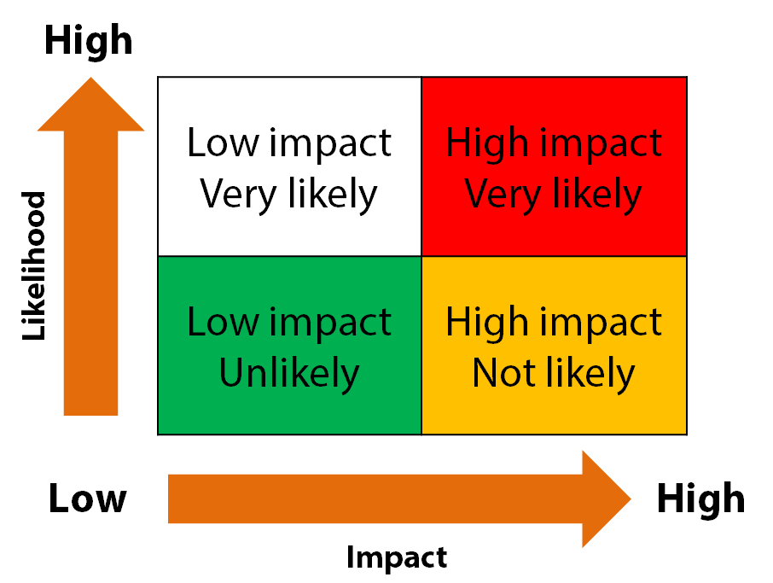
Prioritization based on risk
Impact
how much change
would occur
Likelihood
probability of it
occurring
Notes:
Again we use a 2x2 matrix. In this case the X axis is impact and the Y axis is likelihood.
Refer to Participant handbook Module 11, Figure 11.3.
INFORM participants that they will be doing this as a group activity soon.
For other tools see toolkit and consult:
http://www.fao.org/fishery/eafnet/eaftool/eaf_tool_1/en

Slide 15
Activity: In your groups
Take core problems (and causes) and plot them on a 2x2 risk matrix and then identify the ones that are high risk.
Impact vs. likelihood (Hi/Hi – Lo/Lo)
Take the Hi/Hi risk problems and group them under the 3 EAFm components
Notes:
This is ativity Part B.
See details in Session Plan. Participants work with cards, flipchart, paper and carry out a 2x2 risk assessment.
Groups do a risk assessment for their core problems: either using the low/medium/high matrix (semi quantitative risk assessment) or a simple ranking (can do pairwise or cards).The aim of the activity is that they need to identify those issues which are HIGH RISK, as these are the ones we will develop objectives for, etc. Medium risk issues may also need action or monitoring. Low risk issues need only monitoring.
Now participants group their high risk issues by the 3 EAFm components.
They need to record this in this on flipcharts as well as in their workbooks (allow 10 of the 30 minutes to ensure outputs are written up).
3. Agree goals for EAFm plan. Participants write up in their workbooks.

Slide 16
2.3 Goals
Take the high impact, high likelihood problems and causes and use these to develop three (or more) goals, relating to the three components, social, ecological and governance) of the EAFm
A goal paints a picture of what it you want different components of the FMU to look like in the future (5-10 years time)
For example:
“Restored and sustainably managed fisheries and other living aquatic resources and habitats”
“Improved livelihoods of communities that are dependent on the fisheries resources”
“The FMU is well governed with good compliance and enforcement”
Notes:
It is now time to set goals.
2.3 A goal or set of goals are prepared related to effects identified. A goal is a statement of the desired state (5-10 years time) to be reached under the plan.
Relatively general and addresses a set of issues that can be grouped under a theme e.g. the 3 different components of EAFm.
One example is given for (i) ecological (ii) human, and (iii) governance.

Slide 17
The levels of the plan
Vision
Aspiration for the future
1 Vision
Goals
Goals for different set of issues
3-4 Goals under the 1 vision
Objectives
Objective for each priority issue
A number of objectives
under each goal
Notes:
Let’s now refer back to the vision, goals and objectives hierarchy.
This is same slide as session 10, slide 11 (shown before break).
We have one vision, several goals under that vision (one for each theme) and a number of objectives for each goal (one for each issue).

Slide 18
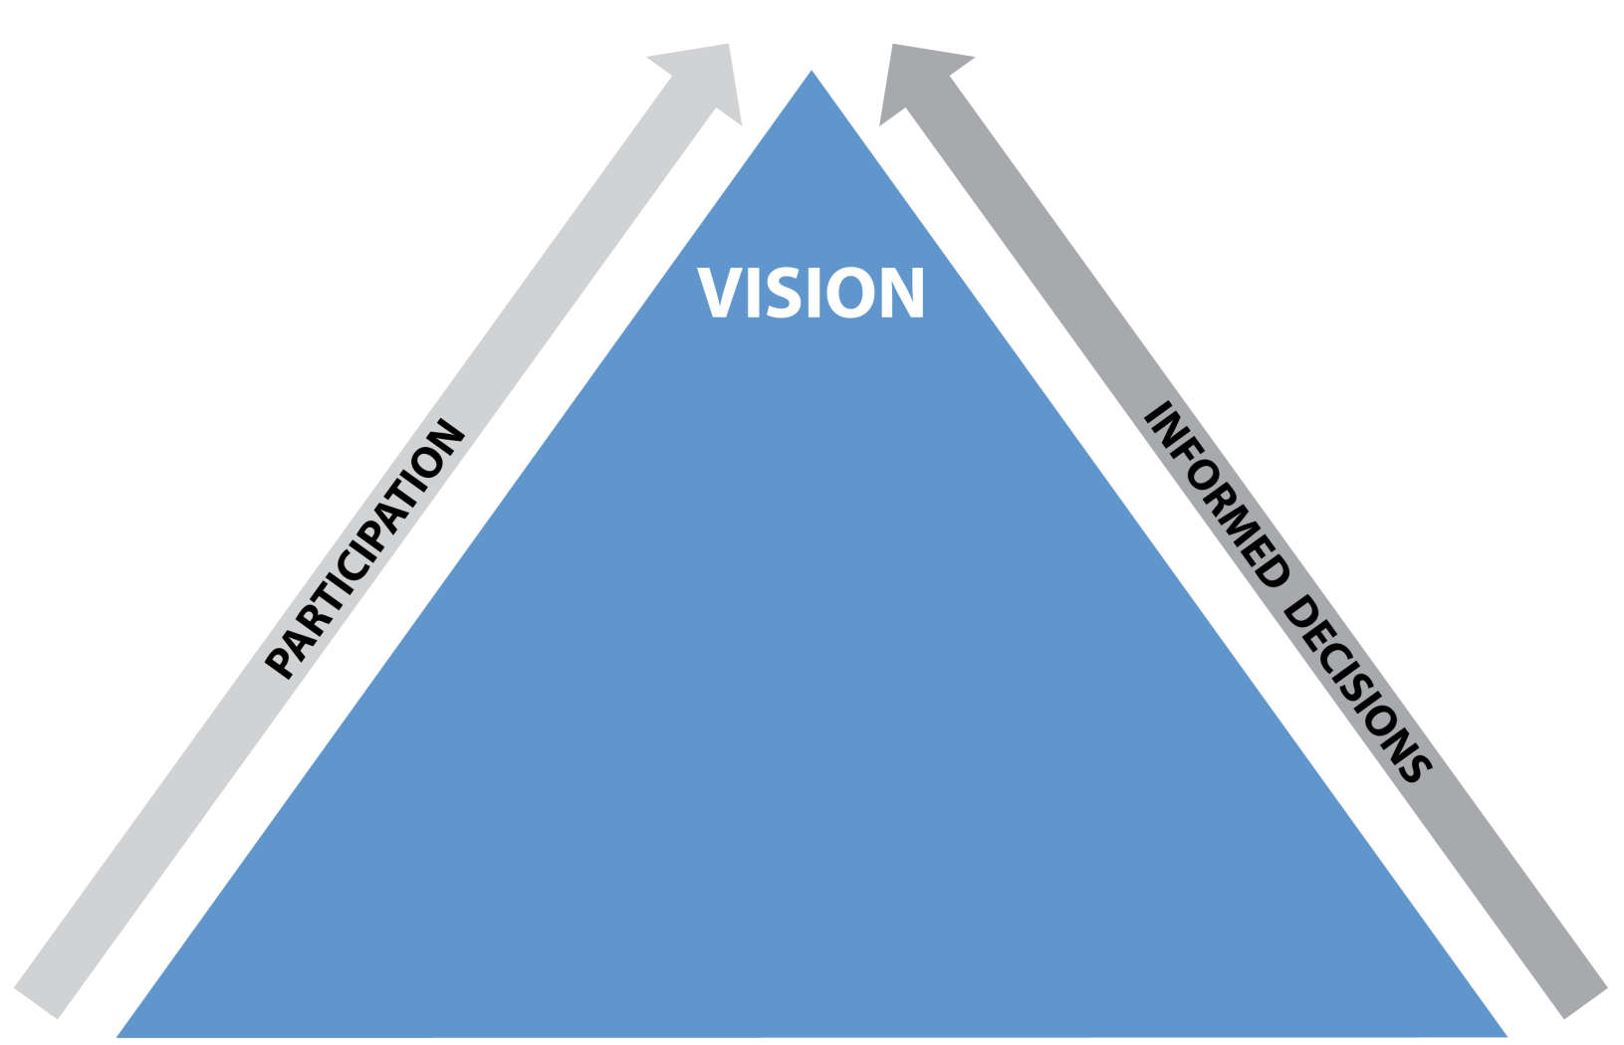
Building the EAFM plan
GOALS
Notes:
Diagrammatically, the top part of the plan looks like this. We already have a vision, so now we need goals.

Slide 19
Activity: In your groups
Remove drivers from the flip chart (these are out of our control)
Group the core problems and their causes within each of the 3 EAFm components
Set a goal, that addresses the effects, for each component
Note: Ecological well-being = fish + environment
Notes:
This is activity Party C.
See details in Session Plan. Remove the drivers as these are out of our control and cannot be managed under EAFm.
Set goals for the 3 EAFm components by looking at the effects, noting that ecological well-being includes 2 sub-components – fish and the environment

Slide 20
EAFm Plan outline We can use the results in the EAFm plan
EAFm Management Plan for FMU X
Vision (Step 1)
Background (Step 1)
Major threats and issues (Step 2)
Goals (Step 2)
3-4 based on core problems and issues
Notes:
We have now finished the first part of step 2 and we can now write Section 3 & 4 of the EAFm Plan.

Slide 21
Key messages
In Step 2:
Identified: drivers, core problems and causes and effects
Problems and causes were prioritized so that only the most important are addressed in the EAFm plan
Set goals for the plan based on prioritized issues
These will lead to setting objectives and effective management actions
Notes:
Self explanatory

